Slide 1








Prevalence, Intensity, and Factors Associated With Soil-transmitted Helminths Infection Among Children Below 14 Years of Age in Transmara West and Transmara East Sub-counties in Narok County, Kenya-2024
Presenter -Serah Nchoko
Co-authors: Wycliff Omondi, Lilian Nabaala, Albert Ngongoni, Carol Munini, Fredrick Odhiambo
Thematic Area: Vector-Borne and Neglected Tropical Diseases
Insert high-resolution institutional Logos – if available
Insert high-resolution institutional Logos – if available
Kenya Health Security Convention | 5th – 8th May 2026 | Mombasa - Kenya
Insert high-resolution institutional Logos – if available

Slide 2
Background
  Soil Transmitted Helminths ( STH) are infections caused by intestinal worm
    Remain a significant public health problem especially among children
Global
Africa region
Over 4 billion people at risk with 2 billion infected (Pullan et al )
Mortality- 9,000 to 135,000 worldwide (Dimyati et al., 2018 )
School-age children are at risk -613 million (Mupfasoni et al., 2019)
Causes one-third of all under-five child fatalities (Brooker et al., 2016)
People at high risk - 350million ( Pullan et al)
African school-aged children infected- 117million ( Brooker et al., 2016)
Kenya
People infected -10 million (Masaku et al., 2017)
Over 5 million children are at risk (Okoyo, Campbell et al., 2020)
Narok county over 300,000 children infected (Mwandawiro et al., 2019b)

Slide 3
Objectives
Broad Objective
  To estimate the prevalence, infection intensity, and factors associated with soil-transmitted helminth among children below 14 years of age in Transmara East and Trans Mara West Sub-Counties
Specific Objective
To determine the prevalence of soil-transmitted helminth among children below 14 years of age in Trans Mara East and Trans Mara West sub-counties
To determine the infection intensity of soil-transmitted helminths among children below 14 years of age in Trans Mara East and Trans Mara West Sub-counties
To determine factors associated with soil-transmitted helminth infections among children below 14 years of age in Trans Mara East and Trans Mara West Sub-counties.

Slide 4
Methodology
Study Site
Narok County-Transmara East and Transmara West Sub-Counties
Study population
Children below 14 years of age who had been living in the study area for at least six months to the interview date
Inclusion
Eligible children who gave their assent and whose parent/guardian gave consent
Exclusion
Eligible children for whom caregivers could not provide their information
Children dewormed within the last 3month
Very sick children
Study design
Method 1/2
Cross Sectional

Slide 5
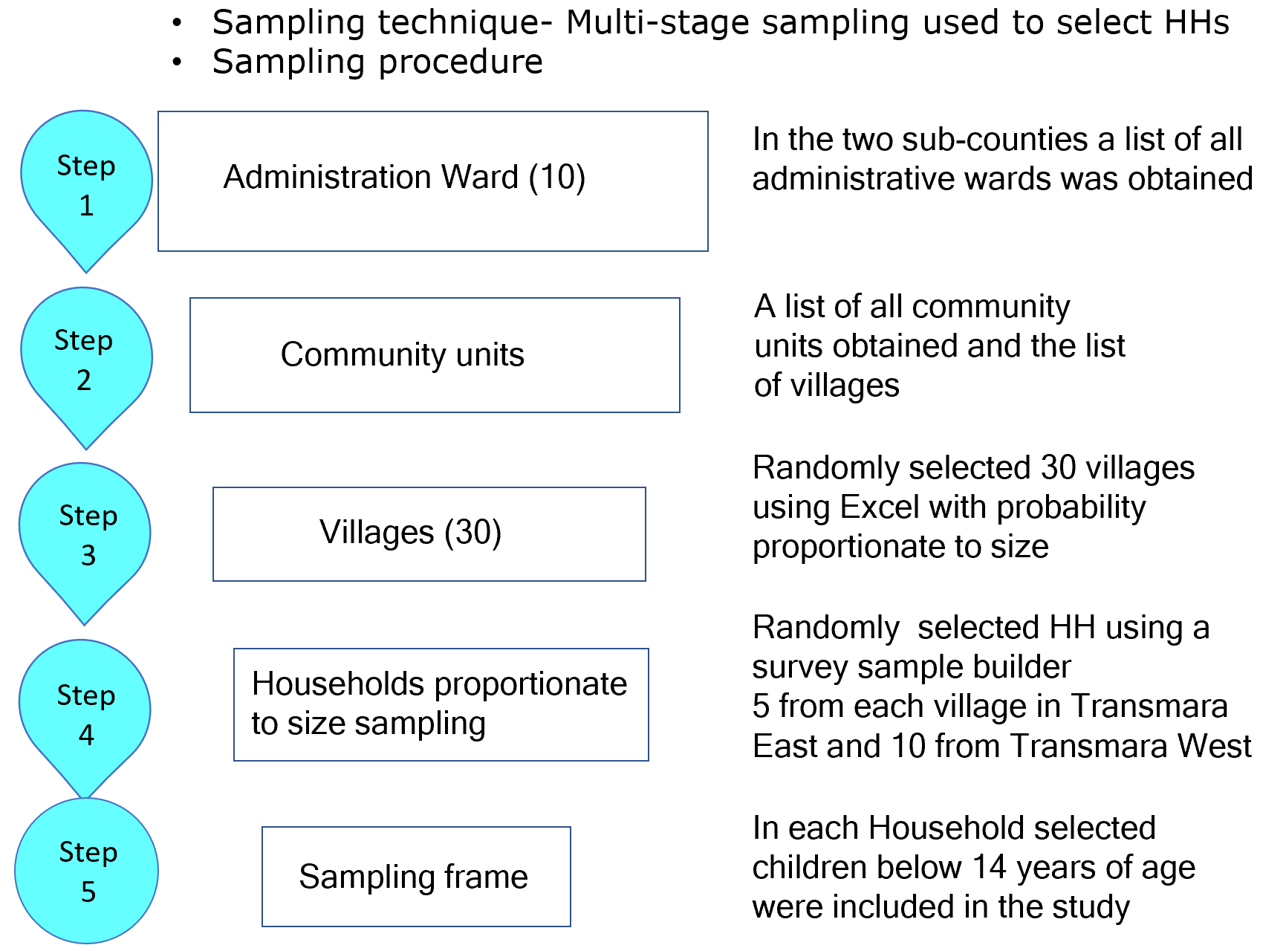
Methodology
Method 2/2

Slide 6
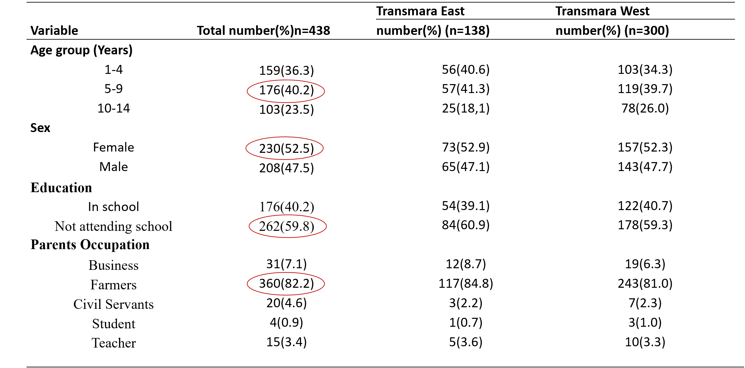
Descriptive Analysis

Slide 7
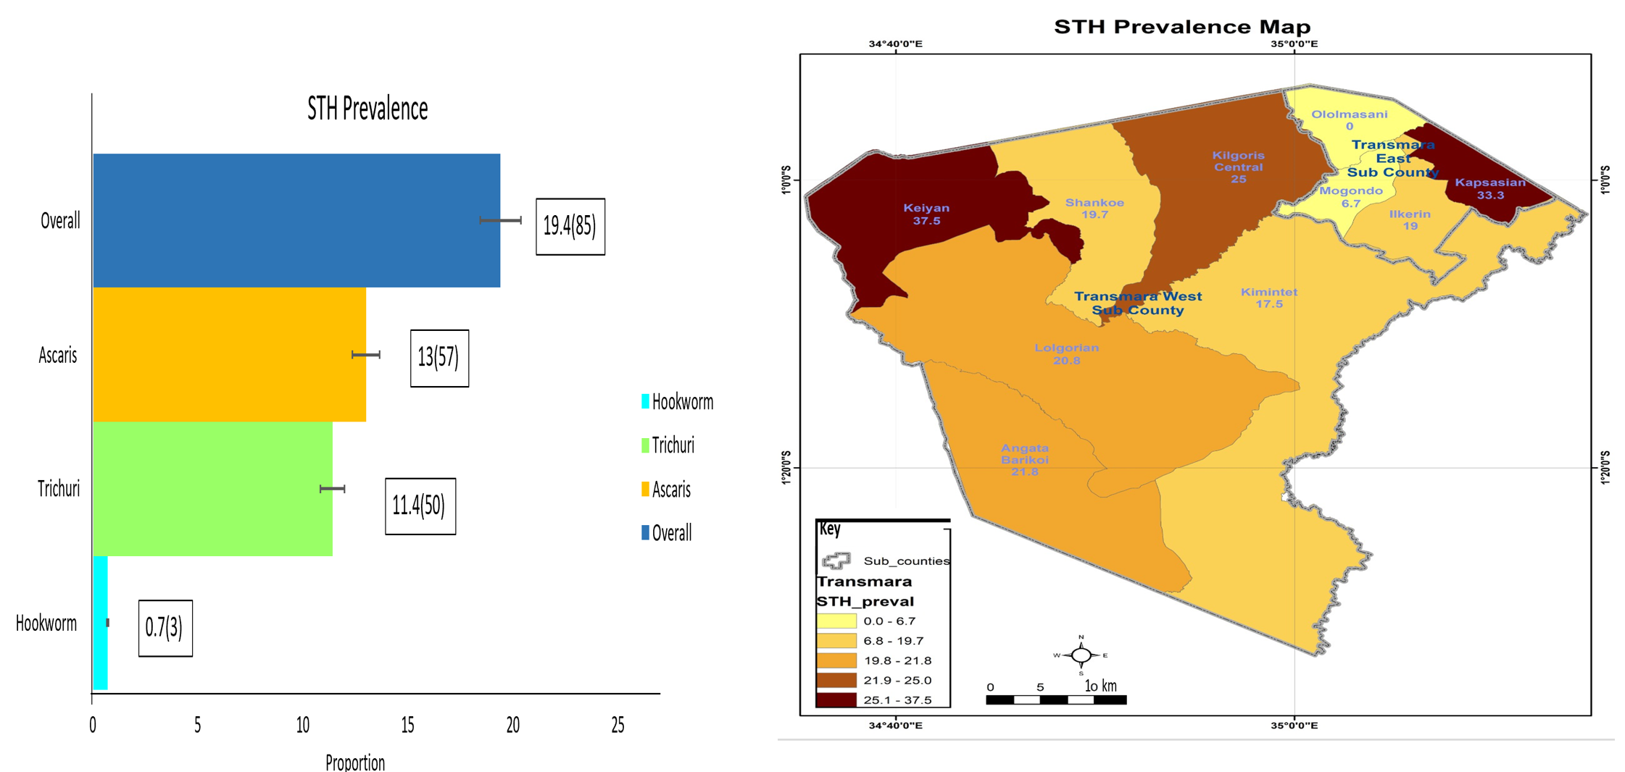
STH Prevalence among children below 14 years of age in Transmara East and Transmara West sub-counties

Slide 8
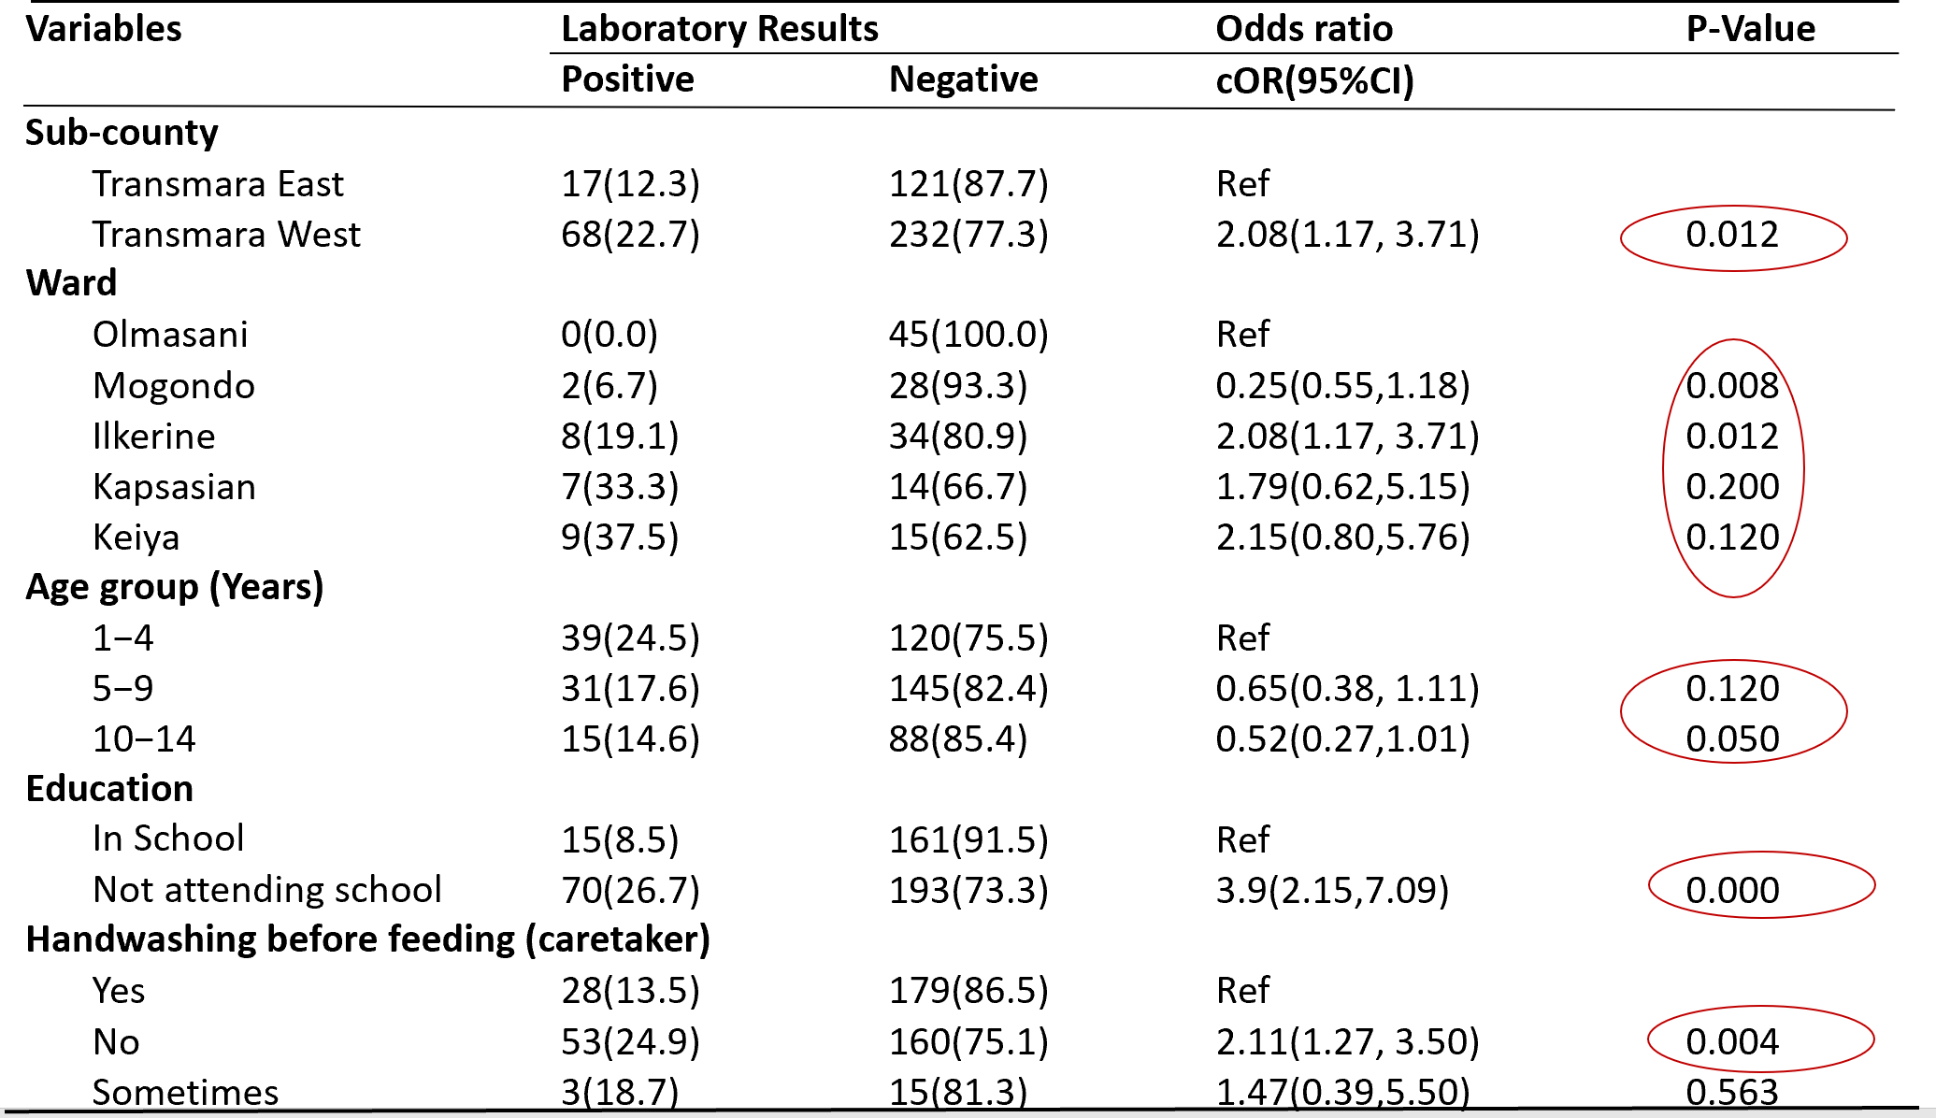
Bivariate analysis of factors associated with STH among children below 14 years of age in Transmara East and Transmara West sub-counties

Slide 9
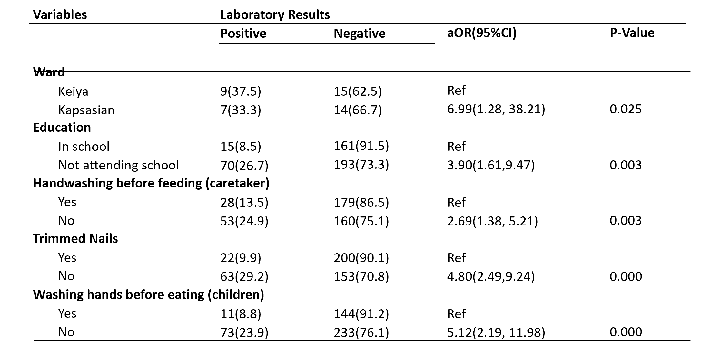
Multivariable analysis of factors associated with STH among children below 14 years of age in Transmara East and Transmara West sub-counties

Slide 10
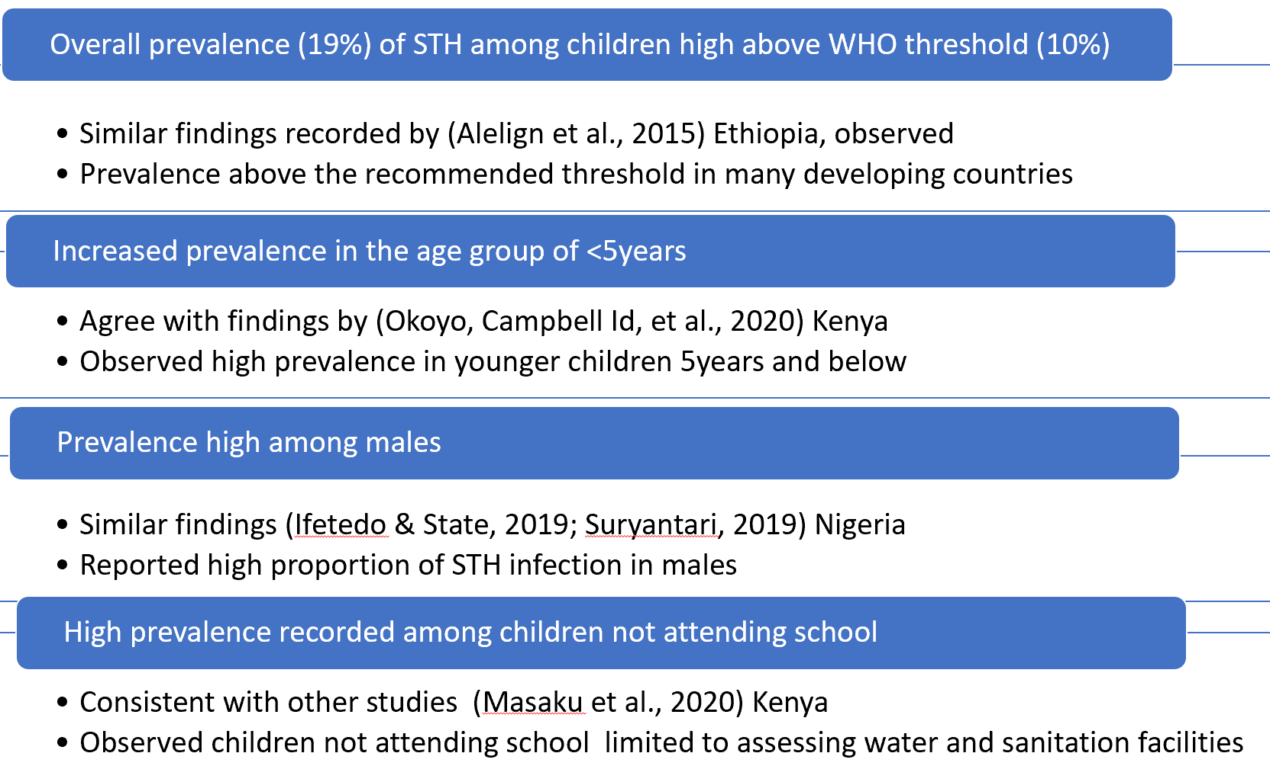
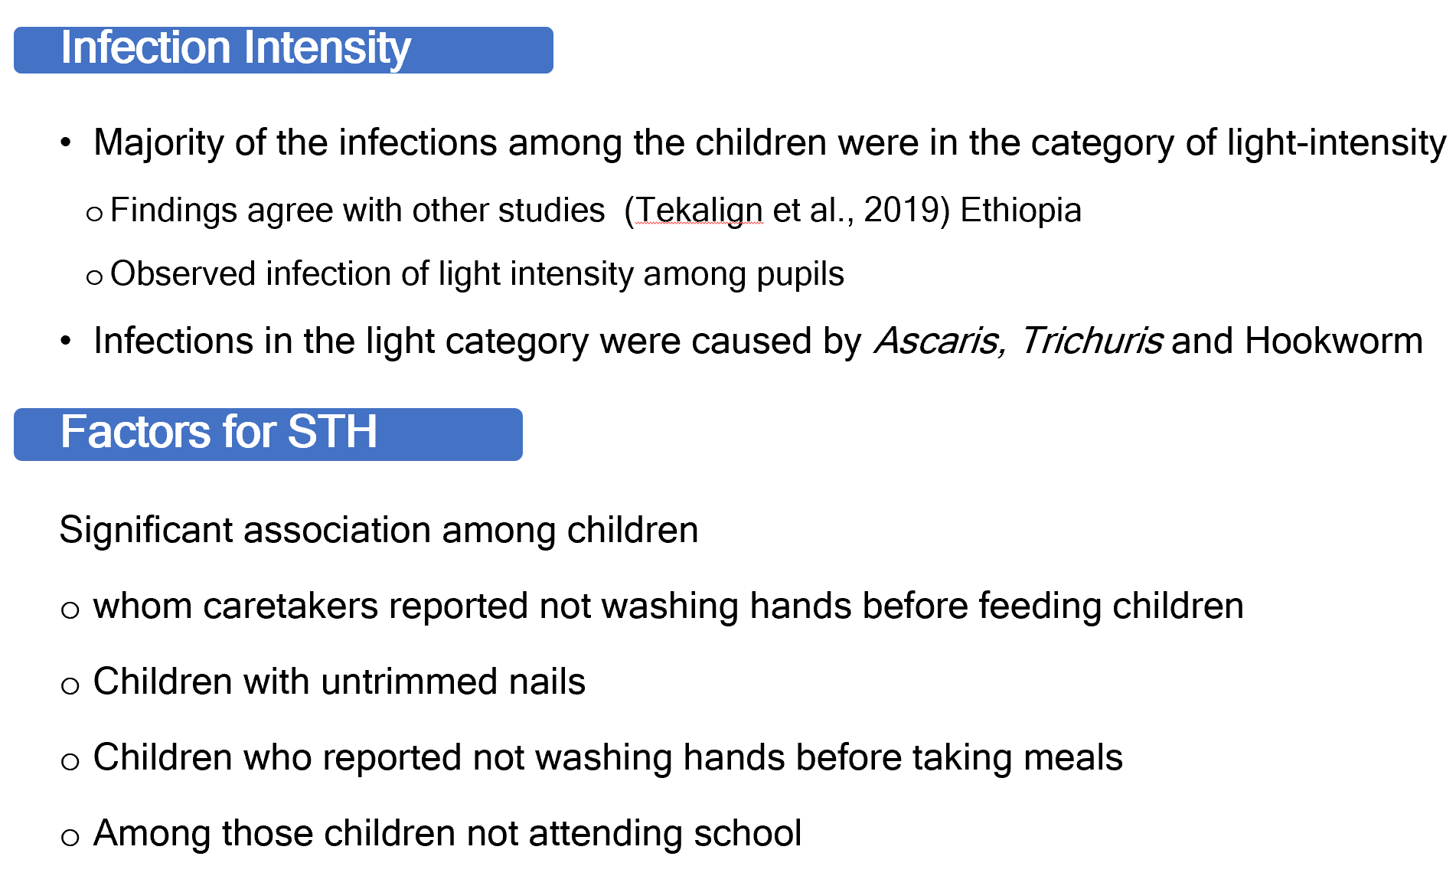
Discussion

Slide 11
The prevalence rate of 19.4% high
  Above WHO threshold of 10% recommended for children
Ascaris lumbricoid caused majority of the infections
Children not attending school were more likely to acquire STH infections
Poor hand hygiene among potential sources of STH transmission
Conclusion

Slide 12
Policy Impact and Implications
The Ministry of Health and Department of Health Narok County to plan
Rolling out Mass Drug Administration (MDA) at the community level to reduce prevalence
A multi-faceted approach by Narok County Department of Health and the Department of Education
Implementing continuous deworming programs in health facilities and schools post-MDA
Promoting school attendance
Department of Health Narok County to promote community engagement
By creating awareness about STH infections, prevention and control.
Emphasizing the importance of good hygiene practices and use of sanitation facilities

Slide 13
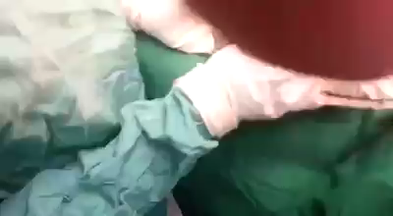






Thank you!
Scan to visit our website
#KeHSCon2026
@NPHIKenya
www.nphi.go.ke

